Slide 1

Conditions , Operators & more
By: Anjali Sharma

Slide 2
Practice
Create a fun interactive page using JavaScript, where students control a bulb and a cat using two buttons — ON and OFF.
When the user clicks on "Turn ON":
Show the bulb ON image
Show the visible cat image
The paragraph should display: "Switch is ON“
When the user clicks on "Turn OFF":
Show the bulb OFF image
Show the hidden cat image
The paragraph should display: "Switch is OFF"

Slide 3
Practice resources
Blub on img : https://d2clawv67efefq.cloudfront.net/ccbp-dynamic-webapps/bulb-go-on-img.png
Blub off img : https://d2clawv67efefq.cloudfront.net/ccbp-dynamic-webapps/bulb-go-off-img.png
Visible cat img : https://d2clawv67efefq.cloudfront.net/ccbp-dynamic-webapps/cat-img.png
Hidden cat img : https://d2clawv67efefq.cloudfront.net/ccbp-dynamic-webapps/cat-eyes-img.png
Button’s Name : “Turn ON” & “Turn Off”
Peragraph text : “Switched On” & “Switched Off”

Slide 4
Type & Conversion
typeof() : used for find type of value of a variable like :
typeof(900) → number ,
typeof(9.2) → float,
typeof(“ram”)→string
Type Conversion : -
Explicit :- (it happen manual type changing)
number to string :- toString()
string to number :- parseInt();
Implicit:- ( when change occurs internally )
“5” + 2 = “52” ;
“5”-2 = 3 ;
true + 1 =2

Slide 5
Operators
Operators | Signs
Arithematic | + - * / %
Assignment | = += -= *= %=
Logical | && || !
comparision | == != > < >= <= === !==
Ternary | Condition ? True : false
Loose equal (==) vs strict equal (===) :
Loose equal compare value not the type of value .
Strict equal compare values strictly with type

Slide 6
Conditional Statements
if (conditionA)
{ Block1;}
else if (conditionB)
{ Block2;}
else
{ Block3;}

Slide 7
Attribute Manipulating
element.setAttribute(“attname”, “newvalue” ) :
We set a new value of attibute for an element
element.getAttribute(“attname”) :
We can get attribute value with this
element.removeAttribute(“attname”) :
We can remove that attribute with this

Slide 8
Practice
Create a counter using JavaScript that allows the user to increase, decrease, and reset a number displayed on the screen. Create a heading (that will show the current count. The initial count should be 0. Add three buttons: Increase, Decrease, Reset
When the user clicks on the Increase button:
The number in the heading should increase by 1.
When the user clicks on the Decrease button:
The number in the heading should decrease by 1.
When the user clicks on the Reset button:
The number in the heading should reset back to 0.

Slide 9
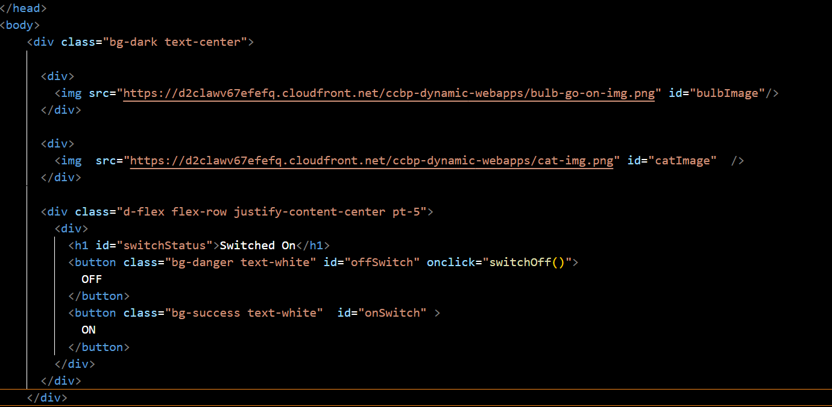
Today’s Practice-1 Code
HTML STRUCTURE

Slide 10
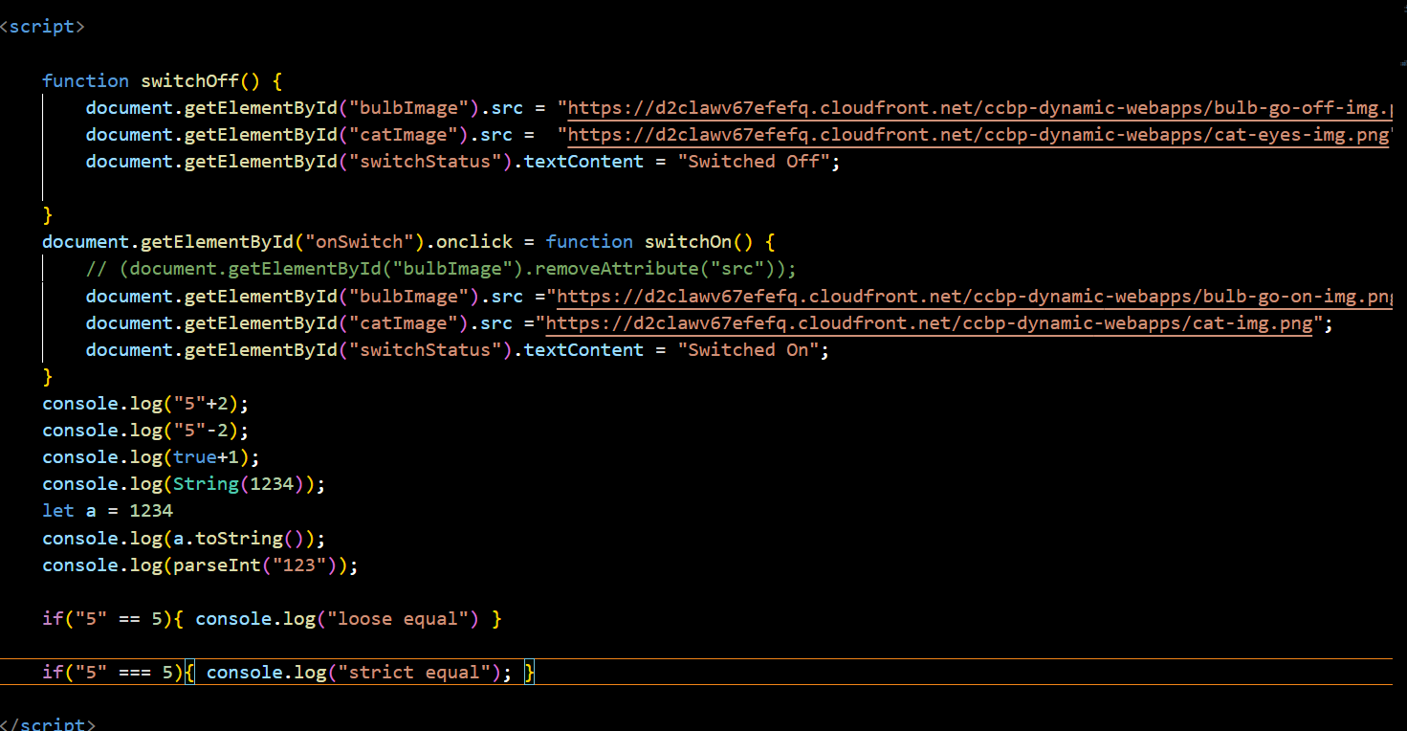
Javascript code & other funcationlity
As today take code as image so that you can write it by yourself , tomorrow , I’ll discuss with you that if you want it on github too

Slide 11

Thank You
ALL THE BEST !!!

